Slide 1

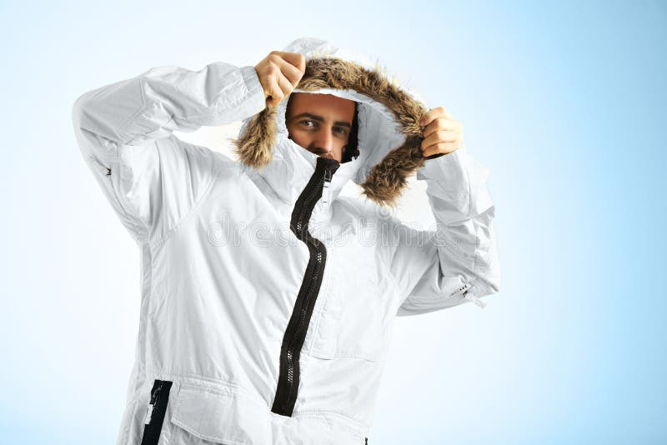
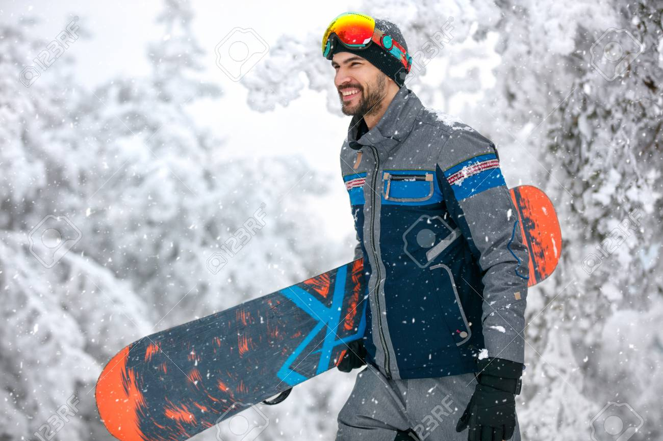
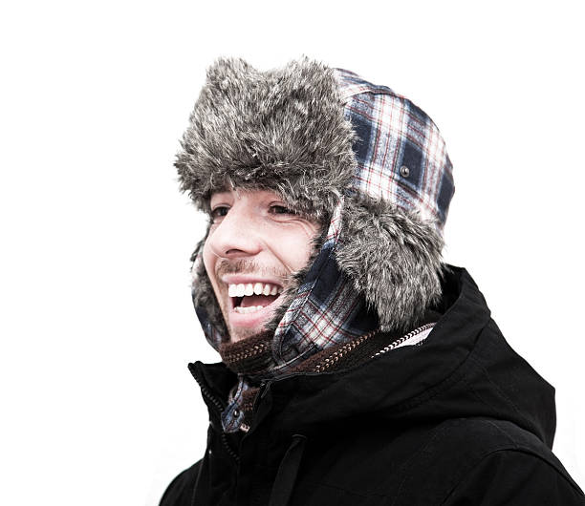
Home Coats Outdoor-Activities Accessories
Shop Snowboard Activities
Shop Accessories
Shop Coats

Slide 2
Home Coats Outdoor-Activities Accessories
Checkout
Sub-total £49.99
Delivery £3.00
Total £52.00
Mens White Parka Coat
£49.99
Size: M
Remove
Add Discount Code
Pay Securely

Slide 3
Home Coats Outdoor-Activities Accessories

